Slide 1



The Library
Object-oriented programming II
Mattias Nordlindh & Görkem Pacaci 1

Slide 2
Project work
• What are we supposed to do?
• What are the requirements?
• How should it be done?
• How will I be examined?
2

Slide 3
What are we supposed to do?
Develop an administrative system for a
library, the application should handle:
• Books
• Book copies
• Loans
• Members
• …
(full specs are in the project document)
3

Slide 4
What requirements?
• Freedom within boundaries, you need to
comply with the specifications
• Functionality
– what are the operations that should be
supported
• Technical
– what techniques should be used
4

Slide 5
High-level Requirements
• Keep a library catalogue (the list of books in the library) and the individual book copies of each book.
• Keep record of library members, and the
books they have on loan.
• Keep a record of all loans, both current
loans and loans previously returned.
5

Slide 6
High-level Requirements
• Keep track of which book copies are on loan and which are still available in the shelves.
• The GUI will need to stay updated at all
time.
• The application should be stable i.e. not
crash by user actions such as invalid input.
6

Slide 7
High-level Requirements
- The Application
• The system should work as a tool for administrative staff
• Should support all operations
in the specification
• Should utilize events to keep all information presented in the GUI up-to- date
There are detailed requirements in the project description.
7

Slide 8
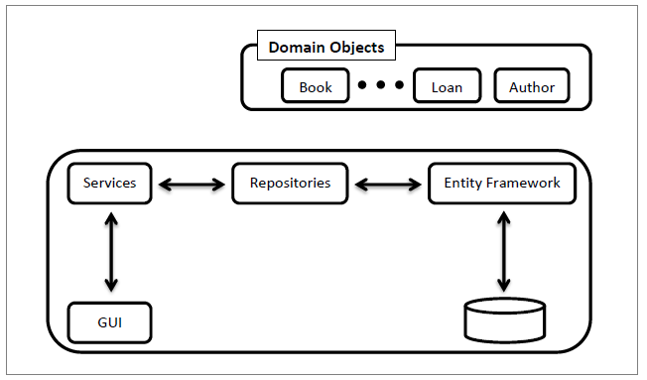
Technical Requirements
- Architectural Design
8

Slide 9
Technical Requirements
- Domain Objects
• Book
– A unique Id
– ISBN number (like ISBN 978-3-16-148410-0)
– A Title
– Description
– A book should have one author
– A book could have zero or more book copies
• Author
– Unique ID
– Name
– A author can write several books ⁹

Slide 10
Technical Requirements
- Architectural Design
10

Slide 11
Entity Framework
• Entity framework (EF) is an Object Relational Mapper (ORM) that makes it easier to store objects in relational databases.
• There is a separate document on the course page named “Entity Framework.pdf” that gives detailed instructions on how to setup and use EF in your project and also some common
problems while working with EF with a code first approach.
12

Slide 12
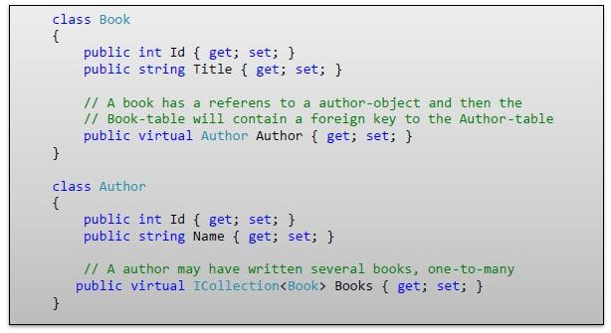
Entity Framework
- Models
13

Slide 13
Conventions vs Annotations
public class Blog{
public int Id { get; set; }
public string Title { get; set; }
public virtual ICollection<Post> Posts { get; set; }
}
public class Post{
public int Id { get; set; }
public string Title { get; set; }
public string Content { get; set; }
public int BlogId { get; set; }
public virtual Blog Blog { get; set; }
}

Slide 14
Conventions vs Annotations
public class Blog{
[Key]
public int Id { get; set; }
[Required]
public string Title { get; set; }
public virtual ICollection<Post> Posts { get; set; }
}
public class Post{
[Key]
public int Id { get; set; }
[Required]
public string Title { get; set; }
public string Content { get; set; }
[ForeignKey(“Blog”)]
public int BlogId { get; set; }
public virtual Blog Blog { get; set; }
}

Slide 15
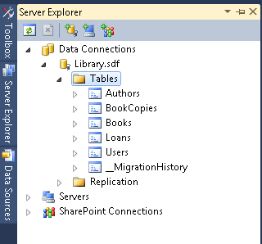
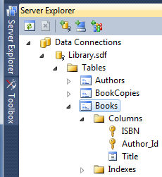
Entity Framework
- The Database
• Entity Framework will create the database and tables, keys, relationsships etc. from the code (model classes)
14

Slide 16
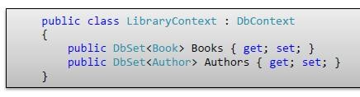
Entity Framework
- DbContext
• Derive from the DbContext-class:
You can add to Books and Authors as if they were lists, and when Save() method is called, they’ll be synced to the database by Entity Framework.
An object retrieved from the database through the EF is tracked, so any changes to the object is saved to the database on Save().
15

Slide 17
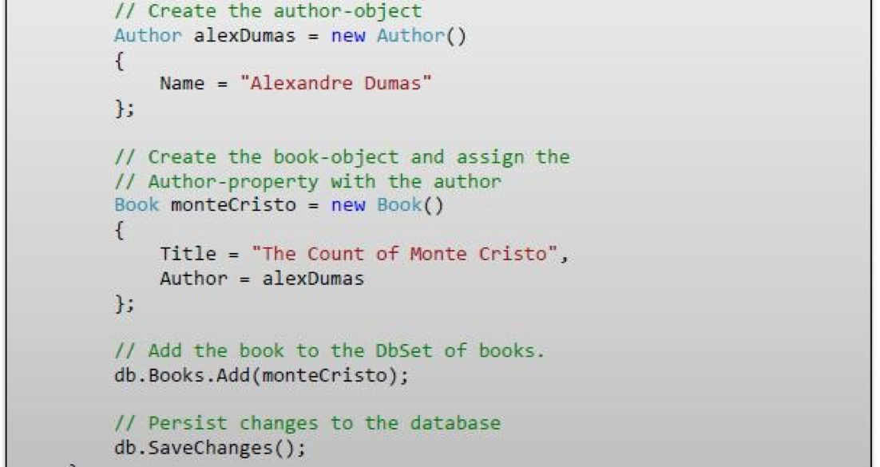
Entity Framework - usage
The ContextSingleton will keep a single LibraryContext for your application, and every repository will have a reference to it.
Repositories are the only place you will access the LibraryContext.

Slide 18
Examination
The project work should be handed in before the deadline.
At a grading session you will present your work and it will be assessed by these criteria:
• Fulfillment of all base and technical requirements of the
specifications.
• How appropriately you use Object Oriented concepts.
• How you follow the different design principles discussed
in the course.
• Usability and Visual efficiency of your UI forms and GUI
design.
• Follow the code standards
17

